Slide 1
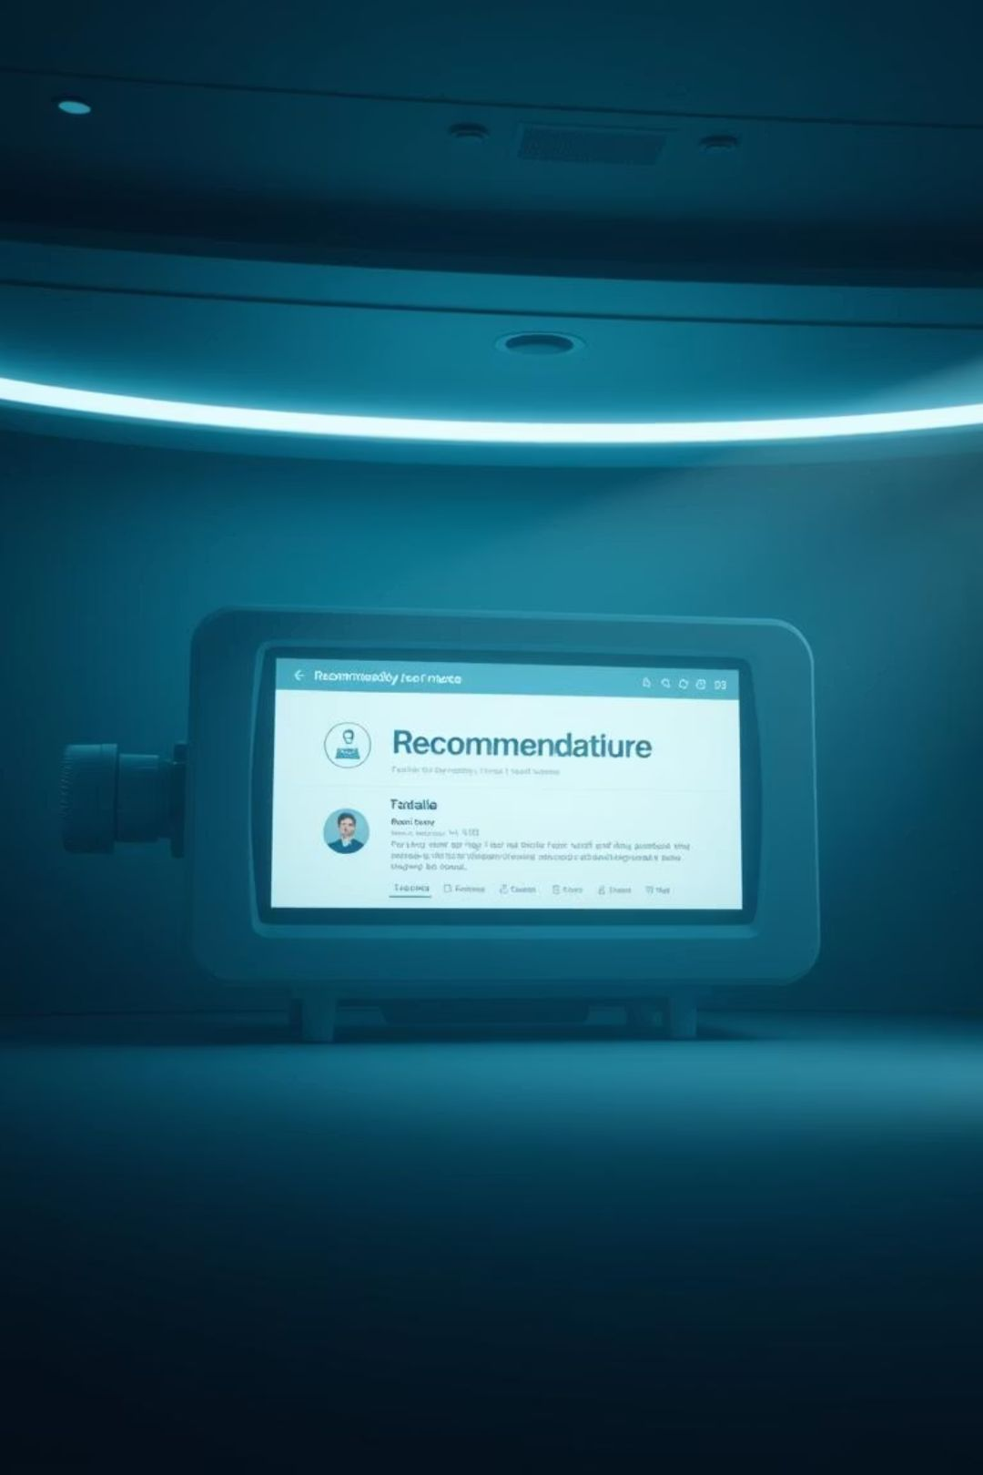
Advanced Movie Recommendation System
Welcome to my presentation on an advanced movie recommendation system. We will explore how machine learning enhances your viewing experience.
By Vamsi Andavarapu – B.Tech Data Science Student

Slide 2

Project Objective: Smart Movie Suggestions
Build a machine learning system.
It creates personalized movie recommendations.
Suggests similar titles.
Based on rich movie content.
Analyzes key features.
Includes overview, cast, genres, and director.
Uses movie keywords.
For precise content matching.

Slide 3
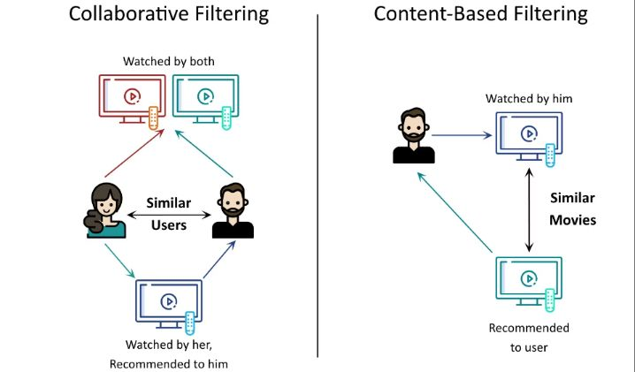




Recommendation Filtering Techniques
Content-Based Filtering
Collaborative Filtering
Utilizes movie attributes. It considers genre, director, and cast. Recommends items similar in content.
Leverages user preferences. Analyzes ratings and viewing history. Suggests what similar users enjoyed.
Movie Features
User Behavior
Content Similarity
Preference Matching
Hybrid filtering combines both for optimal accuracy, enhancing the user experience.

Slide 4
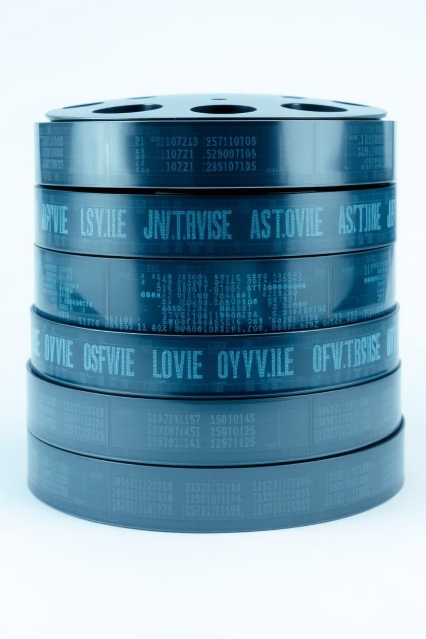
Dataset: TMDB 5000 Movies + Credits
Our system relies on comprehensive movie data for robust recommendations.
Key Data Source
Essential Columns
TMDB 5000 Movies and Credits Dataset provides rich information.
Includes title, overview, genres, keywords, cast, and crew for deep analysis.
Data Preprocessing
We remove missing values. Stringified lists are parsed from JSON. Important attributes are carefully extracted.

Slide 5
Tools and Libraries for Development
Programming Language
Data Handling
Python is our primary development language.
pandas is used for efficient data analysis and manipulation.
Machine Learning
Development Environment
scikit-learn powers our machine learning algorithms. It includes CountVectorizer for text. cosine_similarity measures film relevance.
Jupyter Notebook provides an interactive platform for code development.

Slide 6






System Workflow: Step-by-Step
Load Datasets
Combine movie and credit information.
Extract Features
Parse JSON for cast, crew, and more.
Combine Text
Merge overview and tags into one string.
Vectorize Data
Apply CountVectorizer for numerical representation.
Compute Similarity
Calculate cosine similarity matrix.
Recommend Movies
Suggest top 5 similar titles.

Slide 7

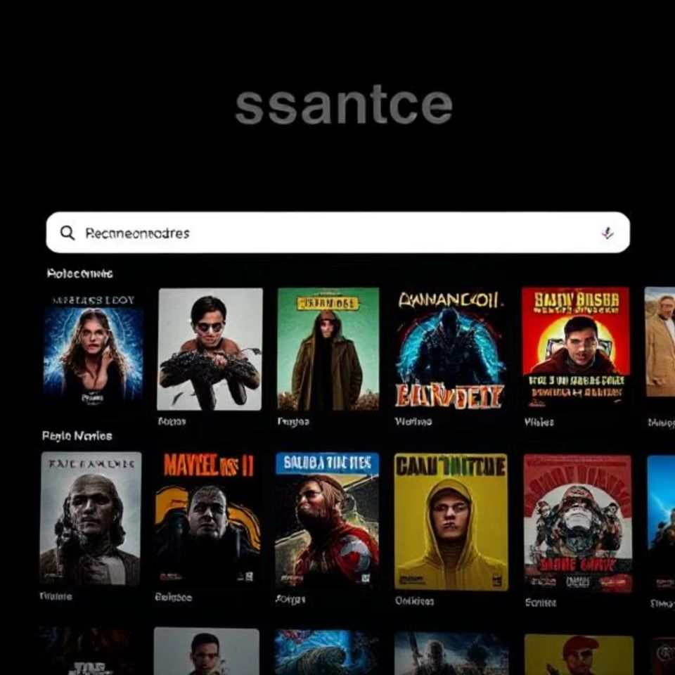
Core Python Functions Explained
convert(text)
Parses JSON strings efficiently. Extracts relevant names from text.
convert_cast()
Identifies and returns the top three actors for each movie.
fetch_director()
Accurately retrieves the director's name from crew data.
recommend()
The main function that suggests similar movies based on input.

Slide 8
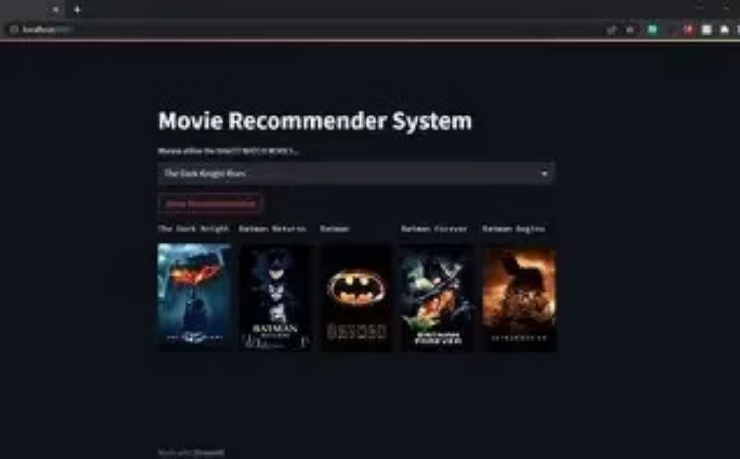
Output Example: Avatar Recommendations
Our system effectively identifies similar movies, as shown with "spiderman."
Input Movie:
Spider man
Recommended Movies:
spider man 3
The Amazing Spider man
Spider man 2

Slide 9
Advantages and Limitations
Advantages:
Limitations:
Easy to implement and deploy.
Doesn't learn individual user preferences.
Fast processing for quick results.
Quality depends on robust metadata.
No user interaction is needed for suggestions.
New movies with missing features are difficult to handle.

Slide 10

Future Scope and Enhancements
We envision exciting improvements to expand our recommendation system's capabilities.
Integrate collaborative filtering for richer personalization.
Explore NLP-based deep learning models for advanced analysis.
Develop a real-time web UI using Flask or Streamlit.
Deploy as a scalable API service for broader use.

